Slide 1


STAT 135 Overview
Concepts of Statistics
“We have got to the deductions and the inferences”, said Lestrade, winking at me. “I find it hard enough to tackle facts, Holmes, without flying away after theories and fancies.”
Inspector Lestrade to Sherlock Holmes
The Boscombe Valley Mystery
06/22/2021
STAT 135
Notes:
Real applicative learning of the facts == not just theorizing on paper

Slide 2

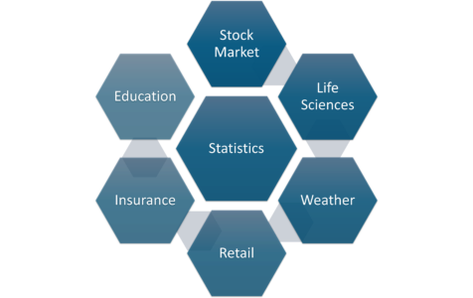
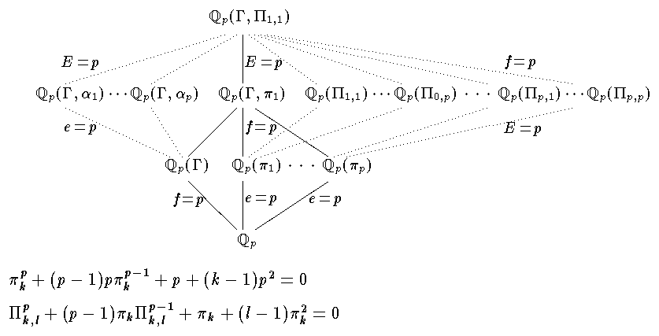
Personal story
No real-life applications
Theories and fancies
Wide uses and applications
Now I am studying extreme weather processes and their climatologies!
Notes:
A random variable is described informally as a variable whose values depend on outcomes of a random phenomenon
A discrete discrete r.v. can take only distinct, separate r.v. can take only distinct, separate values
A continuous continuous r.v. can take any value in some r.v. can take any value in some interval.

Slide 3
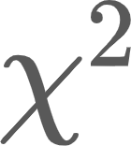
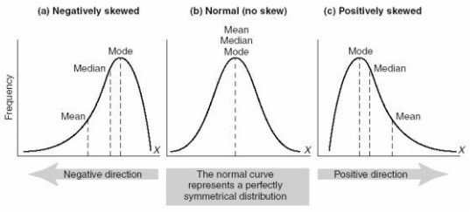
STAT 134: Concepts of Probability
How to define probability properly
Discrete & continuous random variables ↔ distributions
Bernoulli, Binomial, Poisson, Hypergeometric, …
Uniform, Normal, Exponential, , Gamma, Beta, …
Distribution and density functions
Expectation and variance; Conditional distributions
Law of large numbers; Central limit theorem
Theorizing on paper ⇏ Success in real applications
Notes:
A random variable is described informally as a variable whose values depend on outcomes of a random phenomenon
A discrete discrete r.v. can take only distinct, separate r.v. can take only distinct, separate values
A continuous continuous r.v. can take any value in some r.v. can take any value in some interval.

Slide 4
STAT 135: How to learn information from data
bCourses: post course materials, submit homework assignments, participate in discussions, contact instructor / GSIs.
Syllabus: grading scale, exam dates & information.
Extensions: make sure to communicate in a timely manner.
Labs: fill out the Google form so that the GSIs can schedule additional hours for labs.
Exams will mostly be based on the homework and lab practice problems.
Notes:
A random variable is described informally as a variable whose values depend on outcomes of a random phenomenon
A discrete discrete r.v. can take only distinct, separate r.v. can take only distinct, separate values
A continuous continuous r.v. can take any value in some r.v. can take any value in some interval.

Slide 5
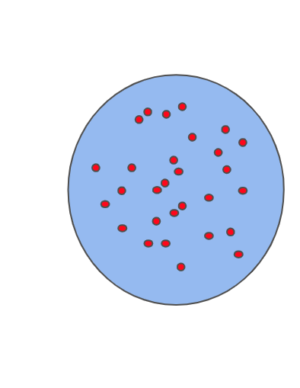
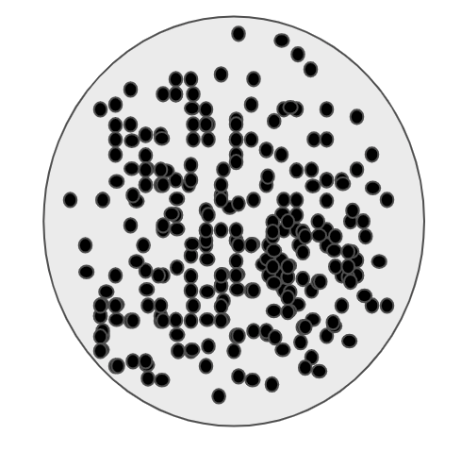
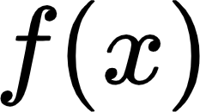
Probability to Statistics
Using collected data to infer properties of an underlying distribution of probability.
Available information
Unknown ground truth
Population: all objects of interest for an experiment/survey that contain the complete information about the true distribution of a variable.
Random sampling
the income distribution of the U.S. population;
the distribution of acreage of wheat in farms across U.S.
Random samples: random observations on the population variable.
Notes:
Expensive and time-consuming to survey every element of the population;
Hard to control the quality of the data: larger staff but poorly trained;

Slide 6
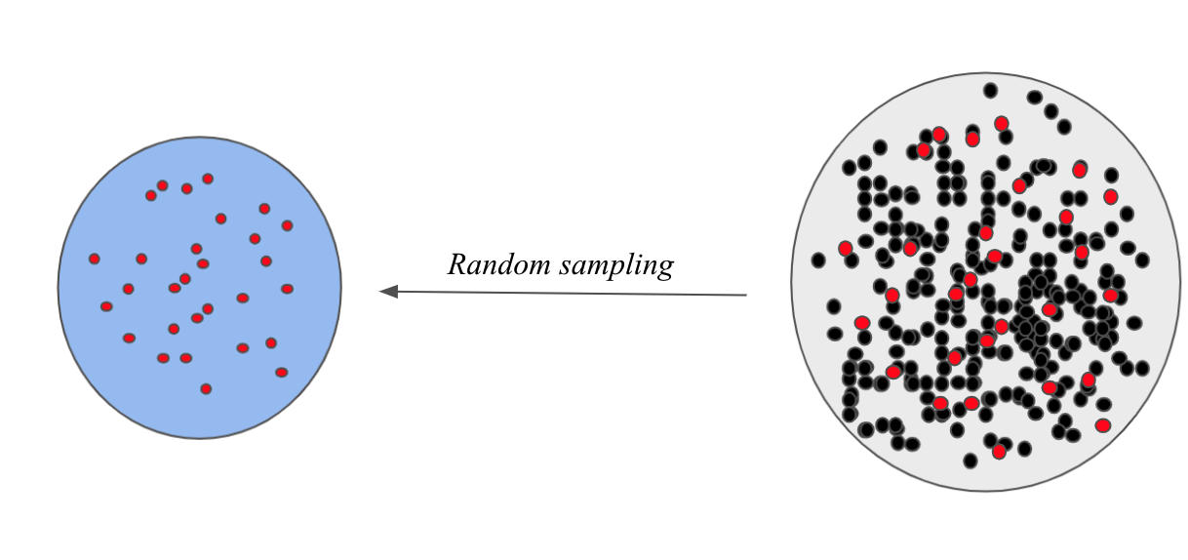
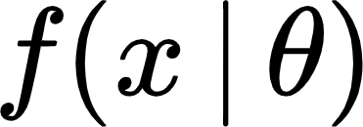
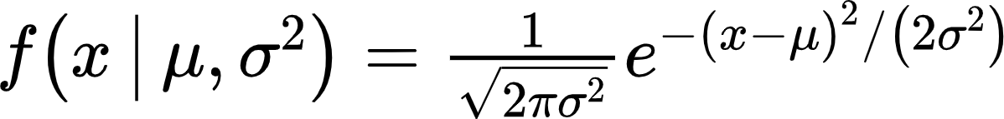

Population vs. samples
Formulate the research problem
How to learn from samples about ?
Population
Make propositions about
Parametric or non-parametric?
?
How [the] translation from subject-matter problem to statistical model is done is often the most critical part of an analysis.
Sir. David Cox
Assume is a parametric distribution .
Only need to estimate .
No assumption on the shape and structure of , which means it is not based on parametric distributions.
More difficult and time-consuming.
Notes:
A random variable is described informally as a variable whose values depend on outcomes of a random phenomenon
A discrete discrete r.v. can take only distinct, separate r.v. can take only distinct, separate values
A continuous continuous r.v. can take any value in some r.v. can take any value in some interval.

Slide 7
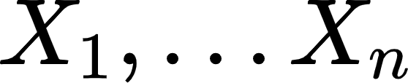
Population vs. samples
Formulate the research problem
How to learn from samples about ?
Population
Make propositions about
Parametric
Survey design & Data collection
?
Randomly collect samples:
Each sample is a random variable.
It is important to appropriately randomize the sampling to prevent investigators biases.
Notes:
--- political group may want some results
The video includes many survey bias examples.

Slide 8

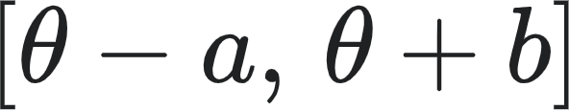
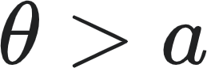
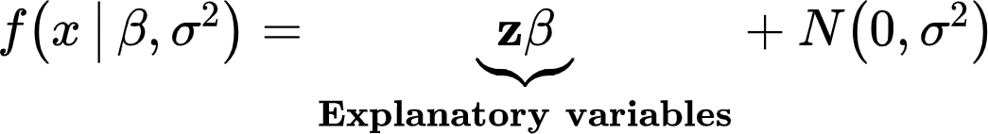
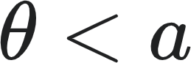
Population vs. samples
Formulate the research problem
How to learn from samples about ?
Population
Make propositions about
Parametric
Survey design & Data collection
?
Parameter estimation of
Point estimate: a particular value that best approximates the parameter of interest.
Maximum likelihood estimators; Method of moment estimators;
Sufficiency; Estimation error quantification.
Conclusion
Interval estimate: an interval that would contain the true parameter with a certain degree of confidence.
Regression: A special parametric model
Hypothesis testing: whether to reject a hypothesis.
?
?
Notes:
A random variable is described informally as a variable whose values depend on outcomes of a random phenomenon
A discrete discrete r.v. can take only distinct, separate r.v. can take only distinct, separate values
A continuous continuous r.v. can take any value in some r.v. can take any value in some interval.

Slide 9
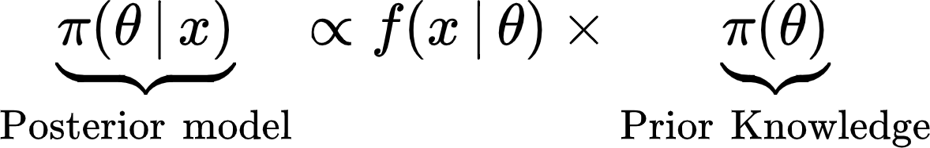
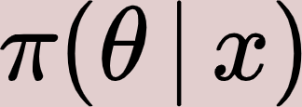
Population vs. samples
Formulate the research problem
Population
Bayesian inferences: Use Bayes’ rule to
derive the posterior model based on a prior knowledge on .
Make propositions about
Parametric
Survey design & Data collection
Parameter estimation of
Bayesian point estimators;
Bayesian credible intervals;
Bayesian hypothesis testing;
Bayesian regression.
Conclusion
Notes:
Posterior combines information from previous experience and new data

Slide 10
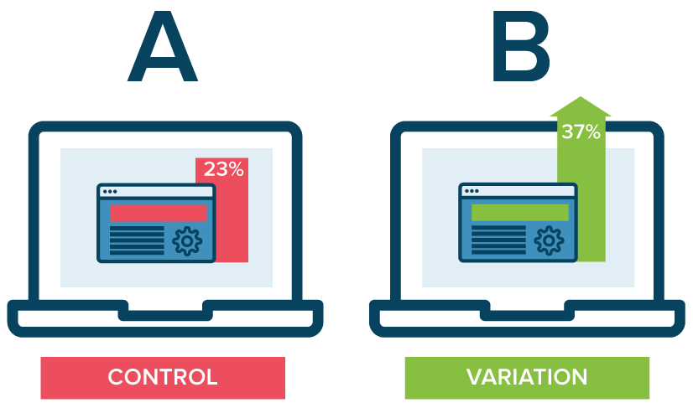
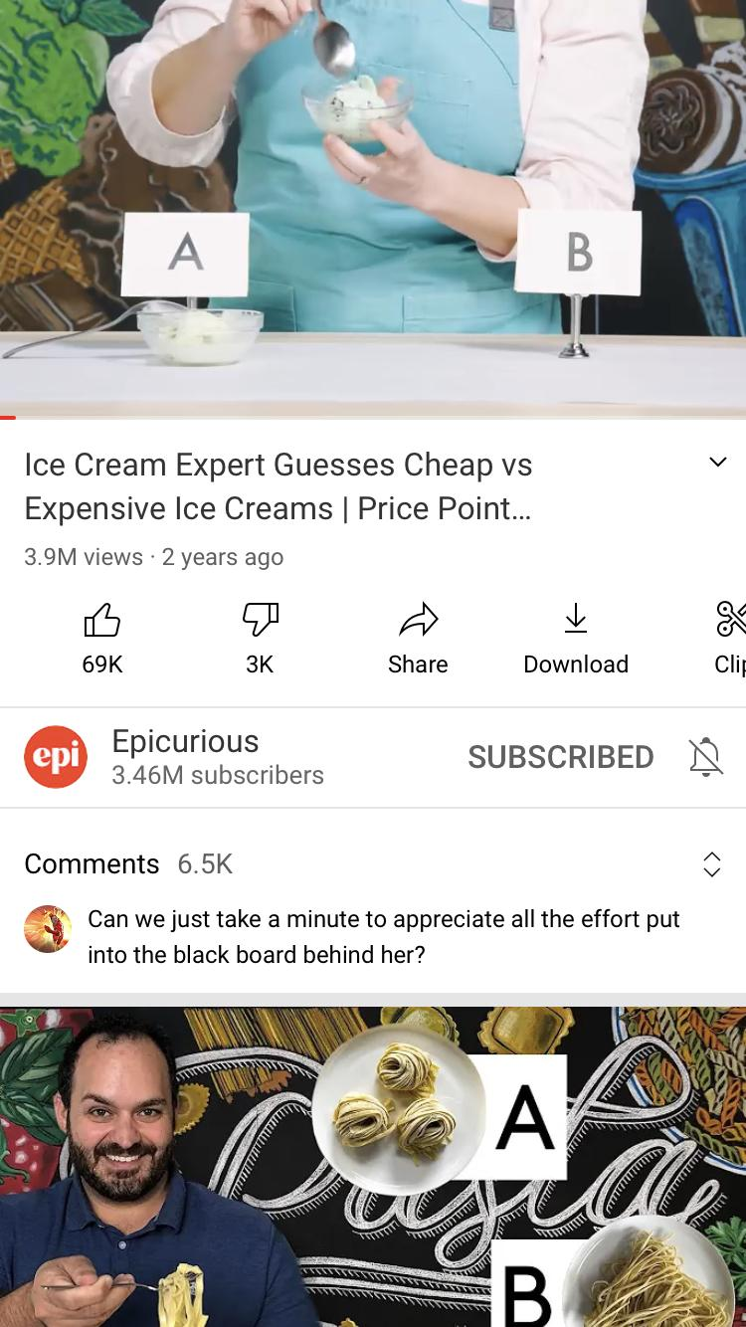
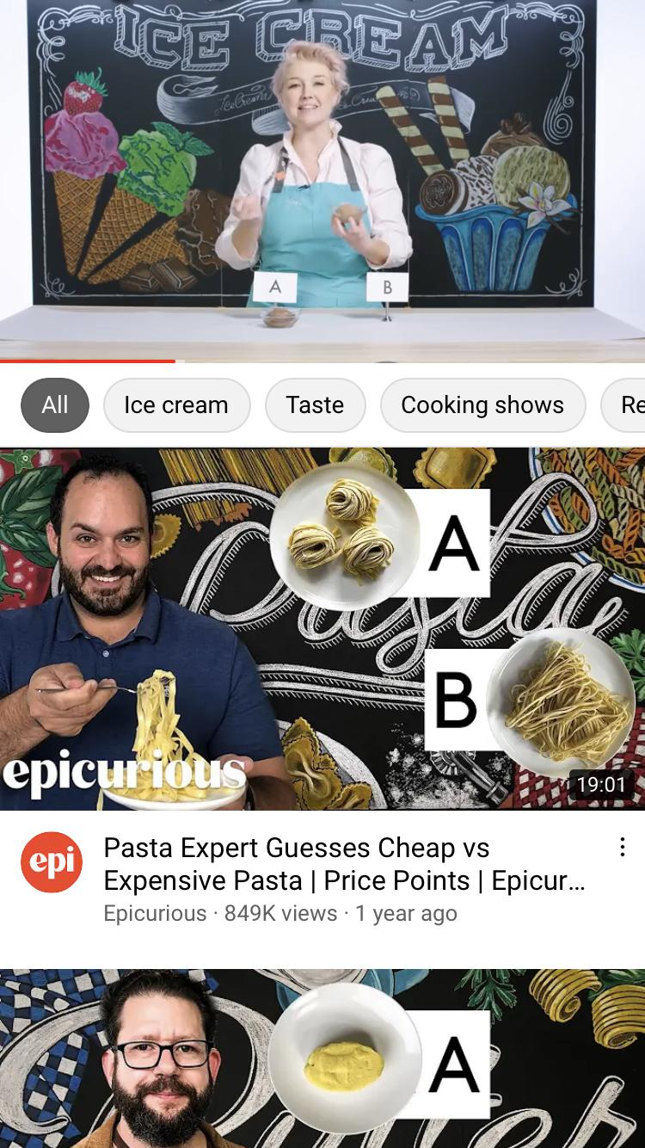

Youtube example: A/B testing
A/B testing : show two variants of an App user interface design to two random groups of uses.
This course will teach you how to use statistical inference tools to determine which variation performs better for a given goal.
Youtube goal: to increase user retention with better UI
Longer view time, higher the advertising value.
Design A: prioritize the comment section
People who read comments tend to finish the video;
Some videos have more heated comment section;
When video playback stalls, comments help retention.
Design B: prioritize the recommendations
Good recommendations drive users to keep watching;
People want to learn more about an interesting topic;
Fast internet further boosts the retention.
Notes:
Goal: For amazon, more orders; For Youtube, longer retention; For Netflix, more subscriptions or more conversions from other streaming apps;
A collaboration between app designer and statistician

Slide 11
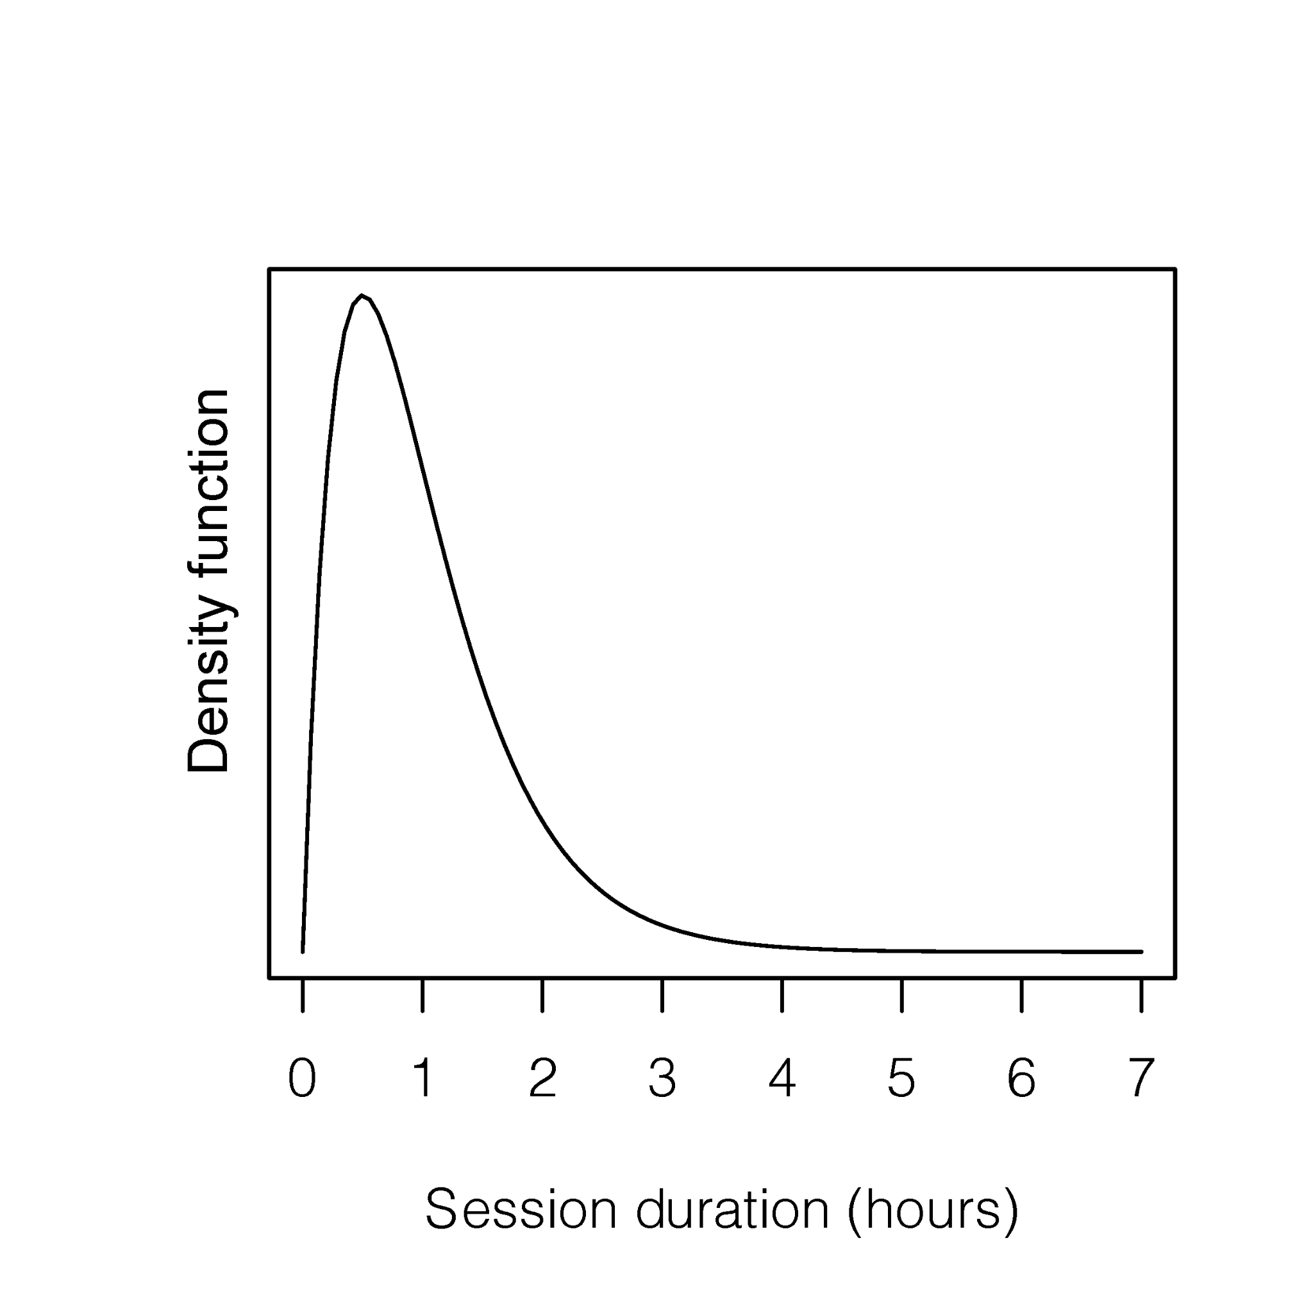
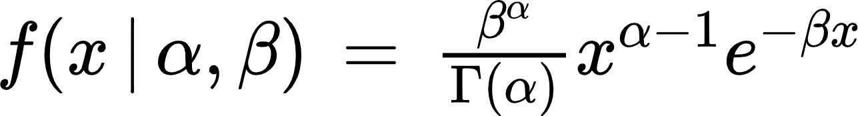
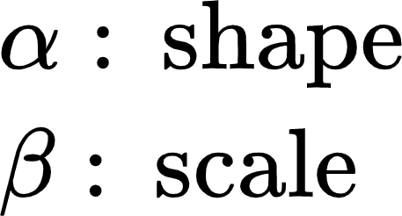
Youtube example: A/B testing
Population: The session view durations of each Youtube Mobile app user
Proposition: The view durations should skew heavily to the right, thus we can assume f(x) is a Gamma distribution
Formulate the research problem
Population
Make propositions about
Parametric
Survey design & Data collection
Parameter estimation of
Conclusion
2.1 billions users as of 2020
Notes:
Long view time: People who binge watch SNL skits or the office clips

Slide 12
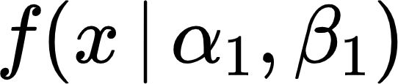
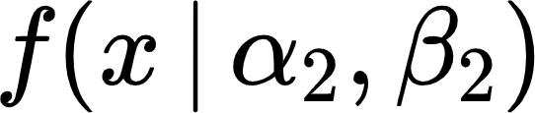
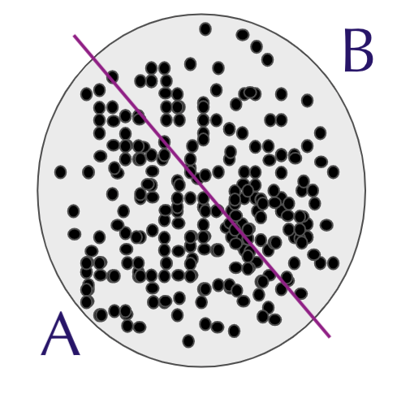
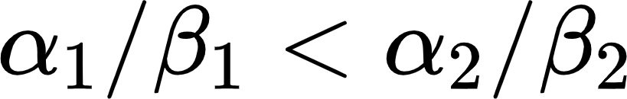
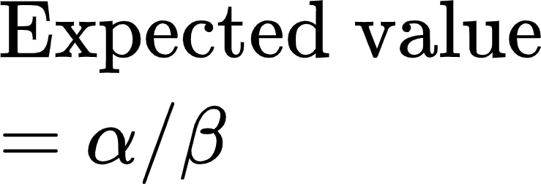
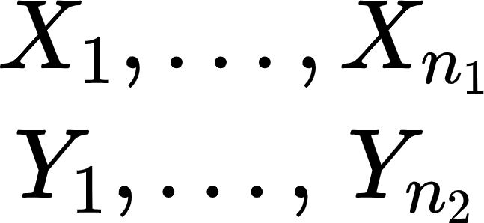
Youtube example: A/B testing
Survey design: Split the population into two subsets, and randomly choose two groups of testees.
Hypothesis testing: Now we have two population distributions and
.
Formulate the research problem
Population
Make propositions about
Hypothesis:
Parametric
Survey design & Data collection
Parameter estimation of
Conclusion
Two samples:
If reject the hypothesis, design A is better;
If fail to reject, design B is better.
From A:
From B:
Notes:
Long view time: People who binge watch SNL skits or the office clips

Slide 13
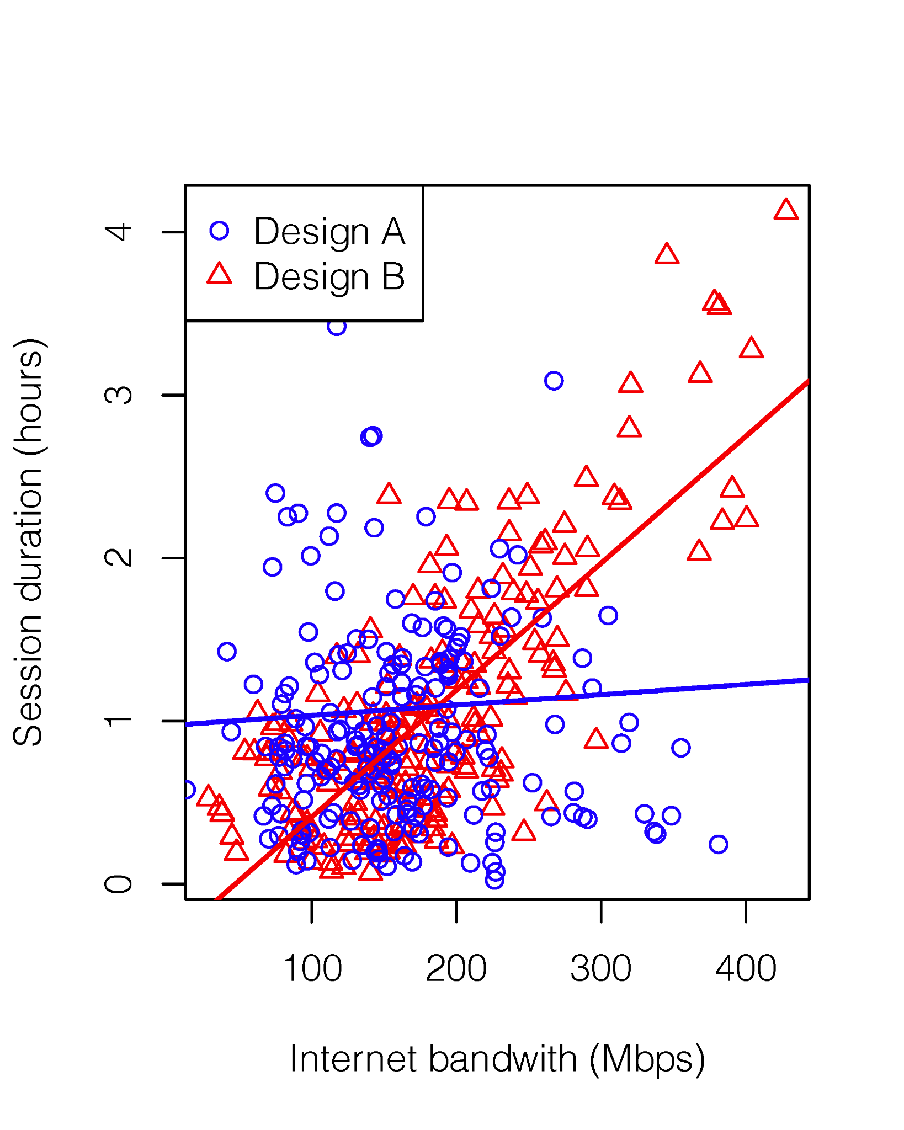
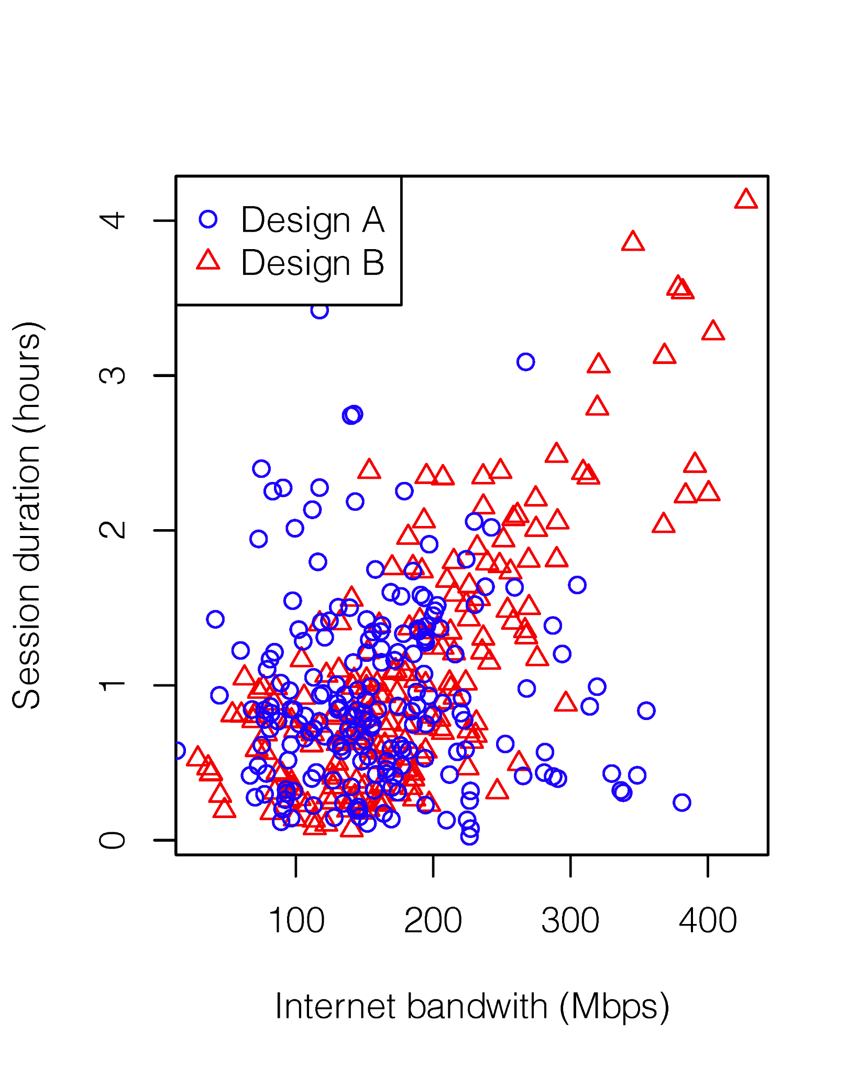
Youtube example: A/B testing
Survey design: Split the population into two subsets, and randomly choose two groups of testees.
Regression: Assume regression models for A and B, and see exactly where B outperforms.
Formulate the research problem
Population
Make propositions about
Parametric
Survey design & Data collection
Parameter estimation of
Conclusion
Two samples:
From A:
From B:
Notes:
What conclusions can we draw from this?

Slide 14
Youtube example: A/B testing
Formulate the research problem
Population
Richer conclusions:
Design B, which prioritizes recommendations, leads to better user retention when the Internet is fast (>200 Mbps).
Design A, which prioritizes the comment section, outperforms when the Internet is slow.
Make propositions about
Parametric
Survey design & Data collection
Parameter estimation of
Conclusion
Implement different designs according to the Internet speed.
Notes:
Long view time: People who binge watch SNL skits or the office clips

Slide 15
Population parameters
06/22/2021
STAT 135

Slide 16
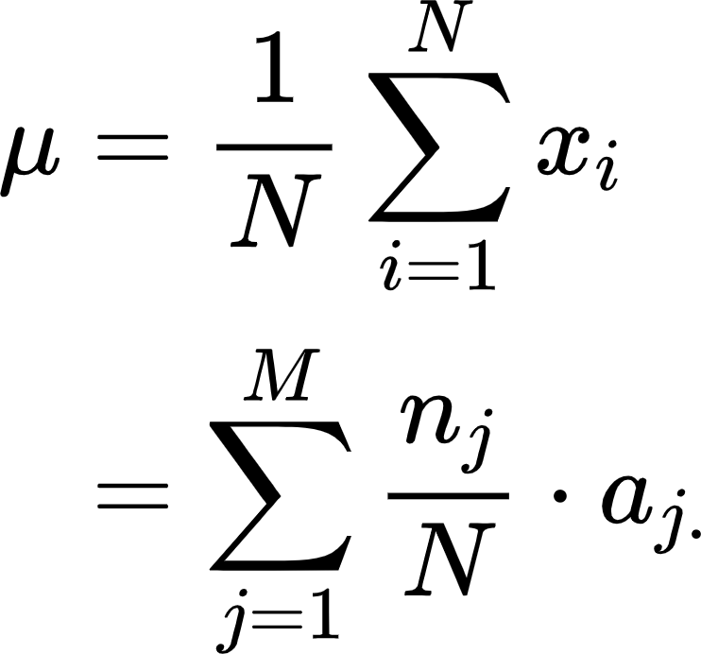
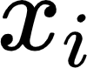
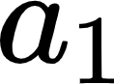
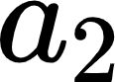
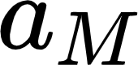
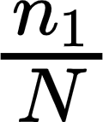
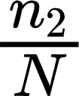
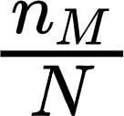
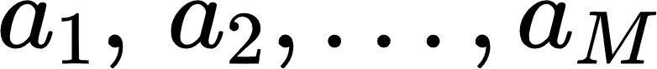
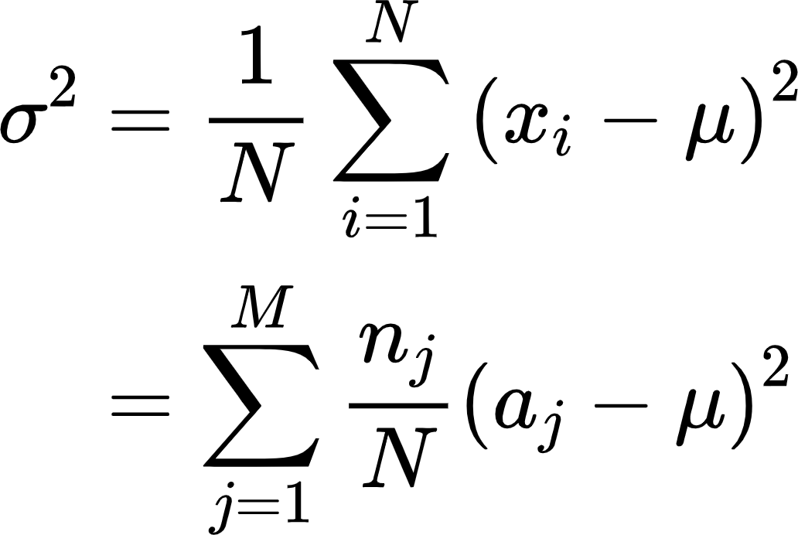
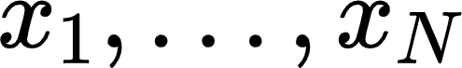
Population mean and variance
Population: Suppose there are N individual objects.
True distribution f(x) should be a probability mass function.
Population mean:
All values can be tabulated via counting each unique value:
pr
Population variance:
in which are M unique values, and are their respective frequencies.
The numerical values of each object are .
Notes:
Long view time: People who binge watch SNL skits or the office clips

Slide 17
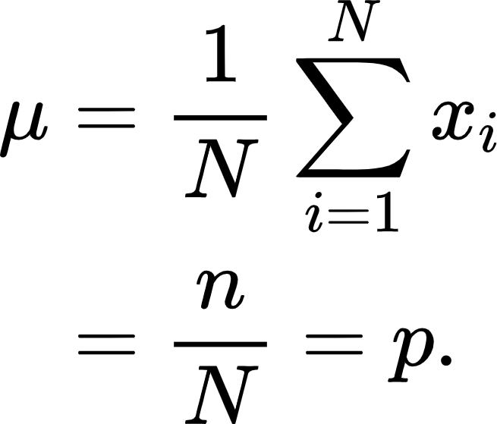
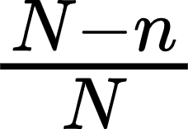
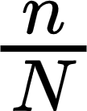
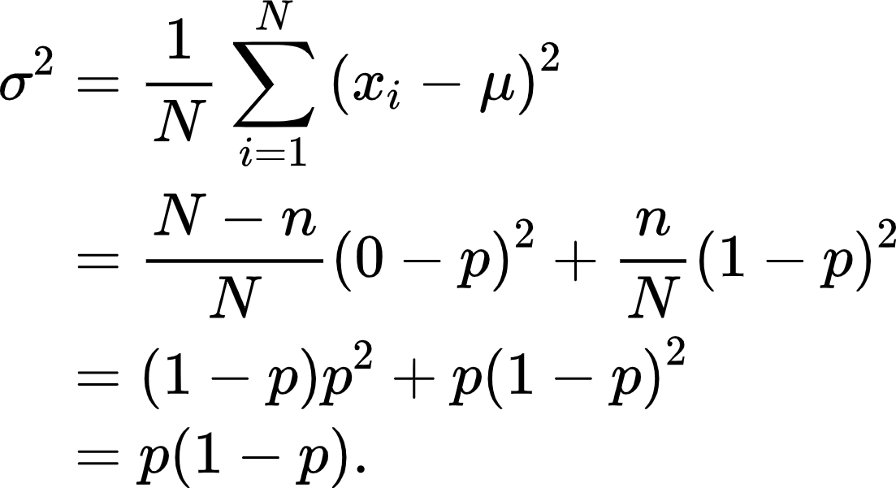
Population mean and variance - Bernoulli
Population: Suppose there are N individual objects.
True distribution f(x) should be a probability mass function.
Population mean:
All values can be tabulated via counting the number of 0 and 1:
 | 0 | 1
pr
Population variance:
are either 0 or 1.
E.g., the hand dominance of all Berkeley residents
Notes:
di·’cho·to·mous: dichotomous
For example, we are interesting in knowing the hand dominance of all Berkeley residents.

Slide 18
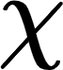
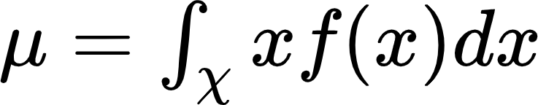
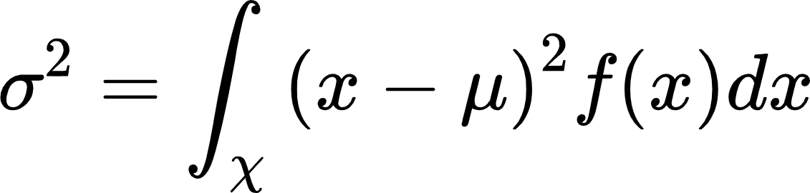
Population mean and variance*
Population: Suppose there are infinite/uncountable individual objects (Probability space is continuous).
True distribution f(x) should be a probability density function if sample space is continuous.
Population mean:
Probability density function is a continuous version of histogram.
Population variance:
The numerical values of all possible objects (sample space) can be continuous/discrete.
E.g., the temperature of every single location on the surface of the earth at 12:00pm.
Notes:
Long view time: People who binge watch SNL skits or the office clips

Slide 19
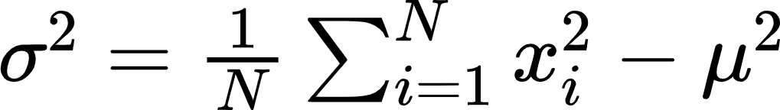



Population mean and variance
Prove
*
Prove
Proof. By definition,
Proof. By definition,
Notes:
Long view time: People who binge watch SNL skits or the office clips

Slide 20
Simple random sampling
= sampling without replacement from a finite population
06/22/2021
STAT 135

Slide 21







Sampling without replacement
Here each sample can be seen as a microcosm of the population
Population mean:
Each particular sample of size n has the same probability of occurrence:
Sample mean:
Sampling without replacement
Sampling distribution: the distribution of each or the distribution of a function of the samples. (It measures randomness before survey sampling is conducted)
Notes:
Combinatorics
encapsulating in ‘miniature the characteristic qualities of the population
‘Mini ture

Slide 22

Sampling without replacement*
Zeno’s paradox:
A one-foot stick, every day take away half of it, in a myriad ages it will not be exhausted.
When the probability space is continuous, things get interesting.
Sampling distribution: If independently drawn, each sample will be identically and independently distributed (i.i.d) according to the true f(x).
Uncountable
Countable
Notes:
In mathematics, sample points are infinitely small compared to a cont prob space, which is why there are inf number of different combinations samples.
What is a infinitely small point? In physics, it might be an atom or a quark. In mathematics, it is even much smaller than that. ‘My riad (Mi ri a d)
The sample points in the illustration is exaggerated. Compared to the prob space, single point is infinitely small. If the prob space has an area of 1, single point has an area of zero in comparison.

Slide 23

Sampling without replacement*
Here each sample can be seen as a discrete miniature of the population
Population mean:
When the probability space is continuous, things get interesting.
Reduction is negligible, or the reduced population remains almost the same everywhere.
Sample mean:
Sampling distribution: If independently drawn, each sample will be identically and independently distributed (i.i.d) under the true f(x).
Uncountable
Countable
Notes:
Still has the population that almost the same everywhere

Slide 24



Infinite population - another example
A coin lands heads with probability . It is tossed 400 times:
Can we assume the sampling distributions of each are identically and independently distributed (i.i.d)?
What is the population? What physical property does capture?
Would the population change after the coin is tossed one time? How about after 400 times?
The coin can be tossed infinite amount of times, and the true probability should capture the proportion of heads landing among those infinite tosses.
For finite population, I.I.D can only be assumed if sampled with replacement.
Infinite amount of tossing
The hand dominance of all Berkeley residents.
Notes:
But if the sample size is large, like the US population, we still assume IID because the limited sampling without replacement won’t change the population fundamentally.

Slide 25
Estimate population parameters
under the i.i.d assumption
06/22/2021
STAT 135

Slide 26




Estimate population parameters
Lemma A. Under the i.i.d assumption, and thus , for
.
Discrete f(x) =
probability mass function
Continuous f(x) =
probability density function
pr
Notes:
Still has the population that almost the same everywhere

Slide 27







Estimate population parameters
Theorem A. Under the i.i.d assumption, .
We say is an unbiased estimator of .
Proof. In STAT 134, we learned that the expected value of the sum of random variables is equal to the sum of their individual expected values. Thus,
By the i.i.d assumption, each . Plug back to the previous equation, and we obtain
An estimator of the population parameter is a function of the sample .
Definition. Suppose we are using as an estimator of , the expected bias is
Notes:
A random sample can be seen as a microcosm of the population: on average, the sample mean equals the population mean.
Hat means estimator, and n means sample size

Slide 28







Estimate population parameters
Theorem A. Under the i.i.d assumption, .
Proof. We know from §4.3 that
(1)
Recall for the same random variables and if the two random variables are independent.
Under the i.i.d assumption, if i=j, and if i≠j. Therefore, equation (1) can be written as
.
Not zero if not i.i.d
Correction is needed when sampling without replacement from a finite population.
Notes:
A random sample can be seen as a microcosm of the population: on average, the sample mean equals the population mean.

Slide 29





Estimate population parameters
An estimator of a model parameter is a function of the sample .
Definition. We evaluate the ‘goodness’ of an estimator by the mean squared error (MSE):
.
Proof. On page 19 of this set of slides, we showed for any random variable
(2)
Apply (2) to the expectation in the definition to get
Notes:
Trade-off

